Slide 1
Smart Team - Smart Meeting
System to Control Attendances in Events
Andrew Trinidad
Caique Bispo Ferreira
Harmandeep Kaur
Robinpreet Kaur
Sejin
Scarbourogh, September 2019

Slide 2
Smart Meeting
System to Control Attendences in Events
Problem Description
Our project
Understanding the solution
Benefits
Subsystems
DFD Diagrams
User Case Diagram
Class Diagram
Database Diagram
Sequence Diagram
Technologies
Conclusion
Q & A

Slide 3
Problem Description
The manual students’ attendance registration processes impact on runtime, control and management.
Less class time, less time devoted to the teaching-learning task and lack of control especially in larges events.

Slide 4
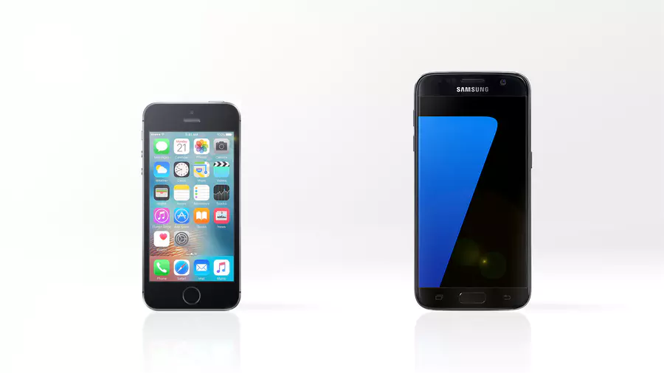
Our idea
What is our idea?
Software design to control the students' attendances in events

Slide 5
Understanding the solution
How does it work?
Ticket
It will be generated by employees and distributed a unique code per student at the end of each lecture of the event.
Validation performs through the website.

Slide 6
Understanding the solution
How will it work?
QR Code
2 images will be generated per lecture and made available through speaker / employees to students to scan with their smartphone (Online / Offline) in two stages (at the beginning and end of each lecture of the event).
If offline, students should sync the smartphone later.

Slide 7
Understanding the solution
How will it work?
Employee :
They will have access to the website to assist students who do not have smartphones, registering their attendance with the student id.

Slide 8
Understanding the solution
- After this process, the students will have a time to validate their attendances.

Slide 9
Benefits
Why we choose this project
√ Computerized System
√ Agility in performing activities
√ Attendance Control
√ Automation
√ Convenience of validation process
√ Manager convenience
√ System Integrity and Scalability
Notes:
O que é este sistema para controle de presenças em eventos
É um sistema que possibilita inserção de eventos dentro do sistema com datas, horários, salas e prédios.
Permitindo a instituição saber e registrar os usuários participantes.
Possibilitando aos alunos “usuários” acessar o sistema e validar os eventos em que estão.

Slide 10
Subsystems
√ Employee Management Subsystem
√ Event Management Subsystem
√ Room Management Subsystem
√ Speaker Management Subsystem
√ Lecture Management Subsystem
√ Student Management Subsystem
√ Attendance Management Subsystem
Notes:
Finalidade do projeto
A principal finalidade deste sistema é permitir a validação dos alunos “usuários” dentro dos eventos ocorridos na instituição, tornando prática e rápida a validação dos mesmos durante o evento através de , e disponibilizando as informações para a confecção dos certificados de participação nos eventos.

Slide 11
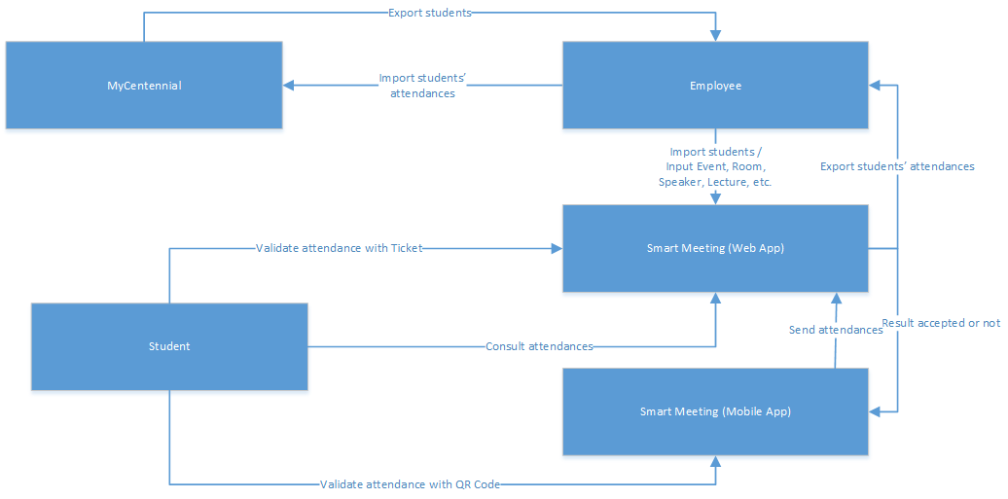
DFD Diagram – General

Slide 12
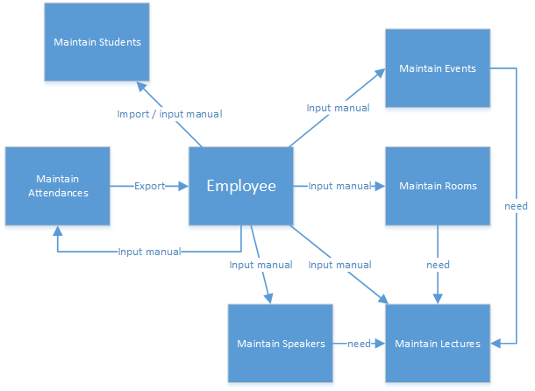
DFD Diagram – Smart Meeting (Web Application)

Slide 13
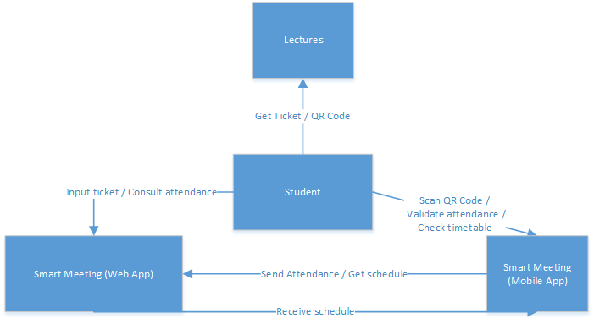
DFD Diagram – Smart Meeting (Mobile Application)

Slide 14
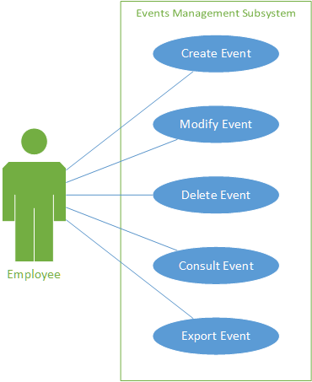
User Case Diagram
Event Management Subsystem
Use Case: | Create Event
User Story:
As a User, I want to create an event.
Acceptance Criteria:
The system should take the user to the create event screen.
The user will enter the events basic information such as description and date.

Slide 15
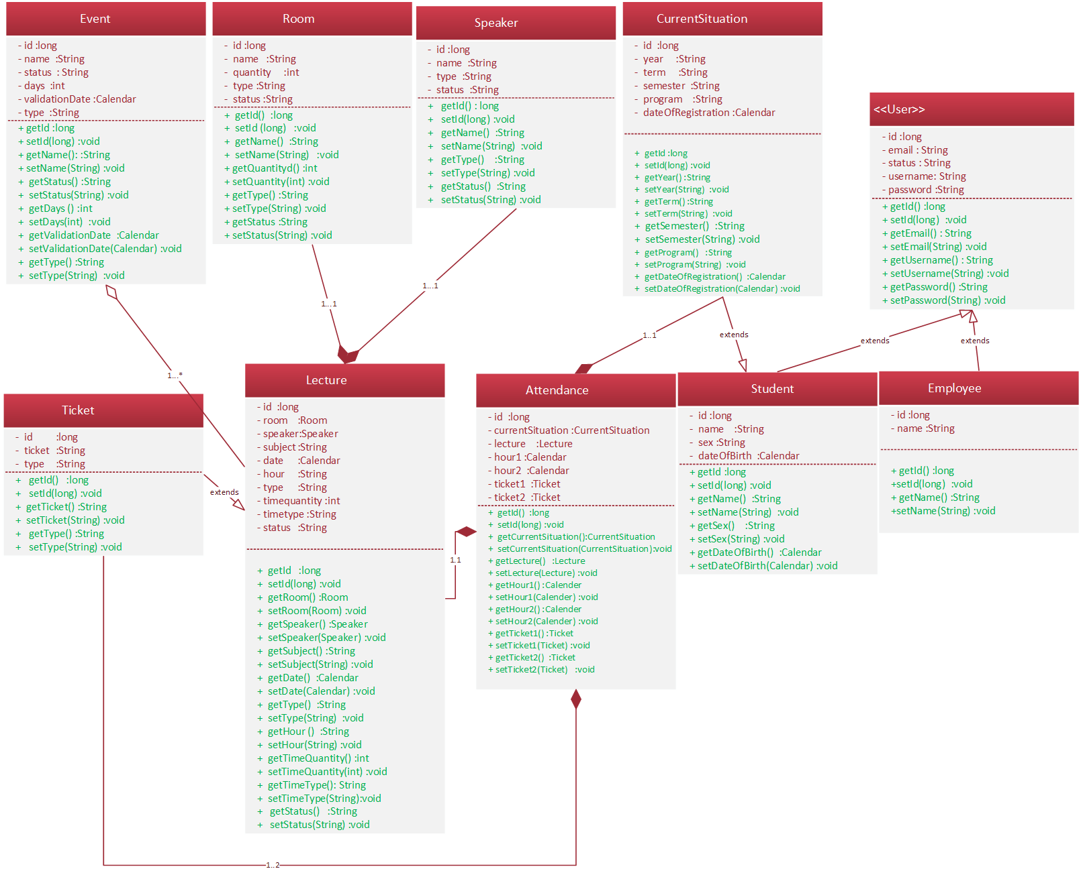
Class Diagram

Slide 16
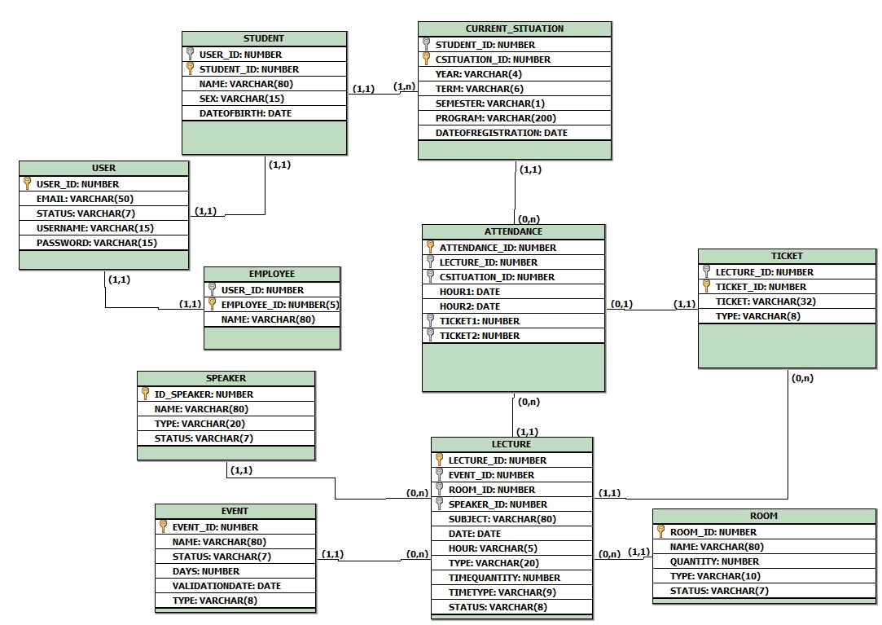
Database Diagram

Slide 17
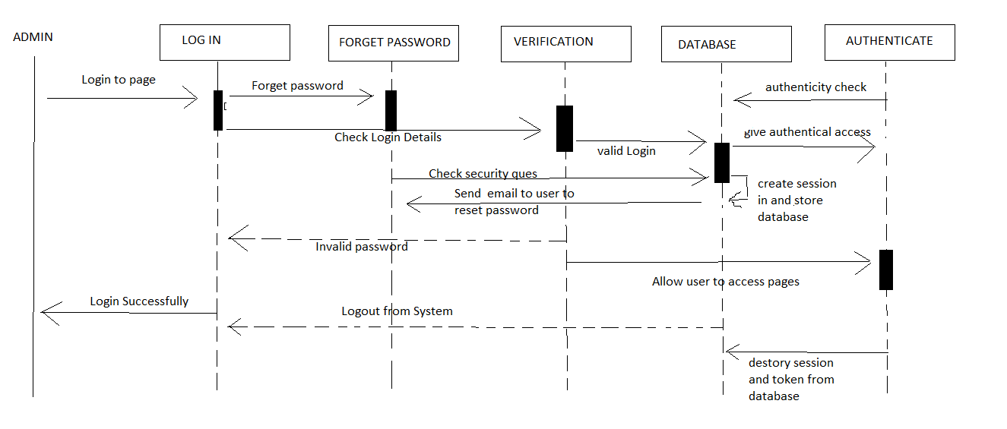
Sequence Diagram

Slide 18
Concepts and Technologies used
JAVA: for web development.
Oracle 12c: Relational Database Manager System.
Apache Cordova: For smartphone application development.
JavaScript: Allied to Apache Cordova, the programming language will be JavaScript.
Bootstrap: For presentation and front end.

Slide 19
Conclusion
Knowledge enhancement in architecture and development of distributed solutions
Time management challenge and task prioritization
Autonomy of members in performing tasks
Development and development of a solution for an underexplored niche market

Slide 20

Q & A

Slide 21

Thank you!

